Slide 1
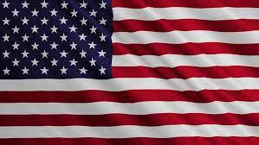
United States of America

Slide 2
America location
The United States of America, colloquially also America - a federal state in North America consisting of 50 states, bordering Canada to the north, Mexico to the south, the Pacific Ocean to the west, the Arctic Ocean to the north west and the Atlantic Ocean to the east.

Slide 3
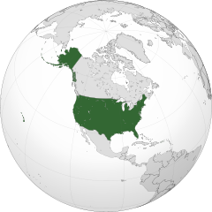
America’s territory
America is 4th in terms of area its surface is 9 373 967 km²

Slide 4
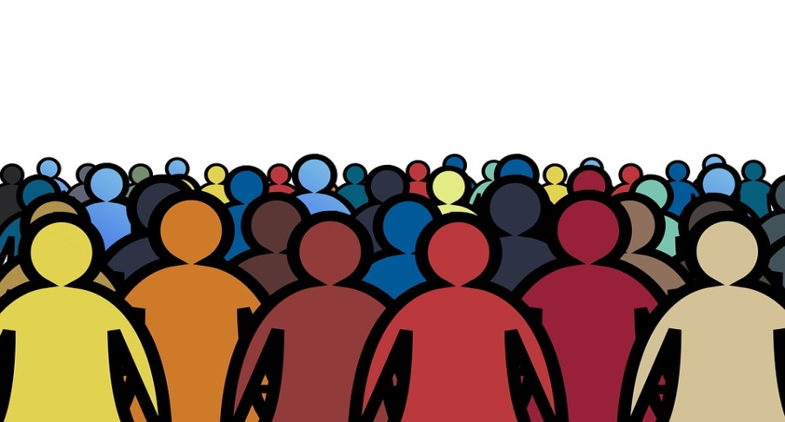
Popullation in America
In America, there are 308,745,538 million
It is estimated that nearly 10 million people of Polish origin live in the United States, and about 600,000 of them use Polish on a daily basis.

Slide 5
The capital and the largest cities of America
The capital of America is Washington
America's largest cities are:
New York 8 336 817 people
Los Angels 3 979 576 people
Chiago 2 693 976 people
Houston 2 320 268 people
Phoenix 1 680 992 people

Slide 6
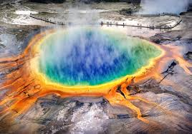
America's geography
America has many volcanoes but the most powerful volcano is the Yellowstone Caldera in Yellowstone National Park

Slide 7
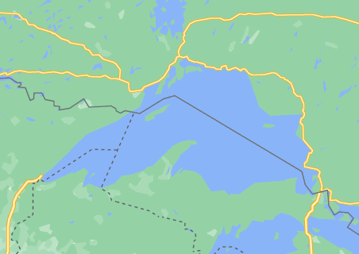
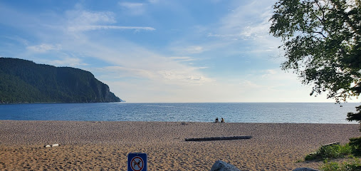
Lakes in the USA
The states have many lakes but the biggest ones are:
Górne, 82 101 km²
Huron, 59 610 km²
Michigan, 57 800 km²
Erie, 25 700 km²
Ontario, 18 960 km²

Slide 8
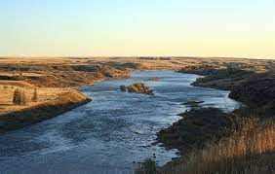
The Rivers
number | Name | length
1 | Missouri | 3768 km
2 | Missisipi | 3544 km
3 | Jukon | 3185 km
4 | Rio Grande | 2830 km
5 | Kolorado | 2330 km

Slide 9
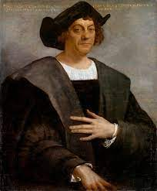
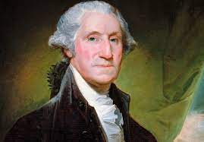
History of America
Kszysztof Columbus discovered America in 1492. This trip lasted two months.
America's first president was George Washington. He was born in 1732 and died in 1799. He became president on April 30, 1789.

Slide 10
Famous death people
1. Janis Lyn Lopin
Born on January 19, 1943 in Port Arthur, she was a very famous singer.
2. Micheal Joseph Jackson
Born August 29 in Gary, has been called the king of pop.
3. Giovanni Maria Versace
Giovanni Maria Versace born December 2, 1946 in Reggio Calabria. Italian precursor and fashion creator.

Slide 11
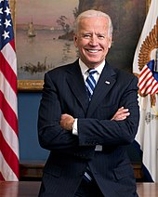
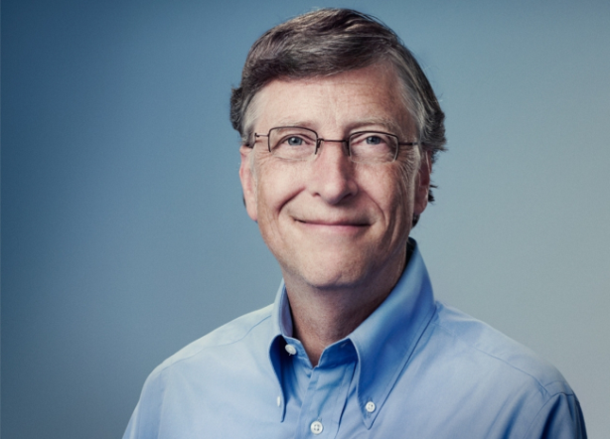
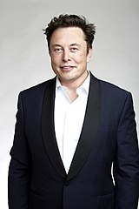
Popular people
1. Joseph Robinette Biden, born on November 20, 1942 in Scranton, is the president of the United States from January 20, 2021.
2. William "Bill" Henry Gates, born October 28, 1955 in Seattle, owns a software company from Microsoft
3. Elon Reeve Musk born June 28, 1971 in Pretoria, founder of the Tesla company

Slide 12
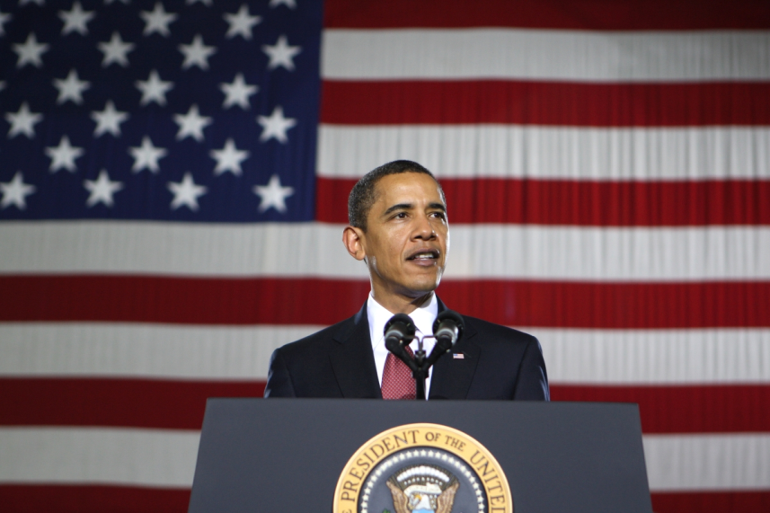
Popular people
Paula Abdul, born June 19, 1962 in San Fernando. She was a juror on American Idol.
Barack Hussein Obama American politician born on August 4, 1961 in Honolulu.

Slide 13
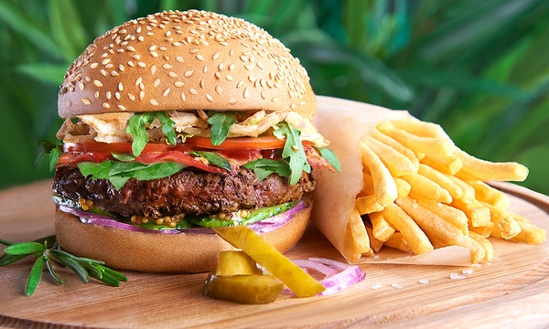
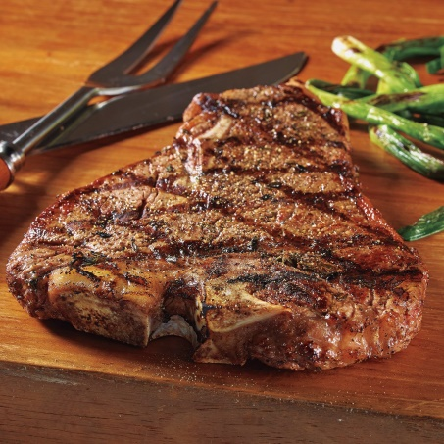
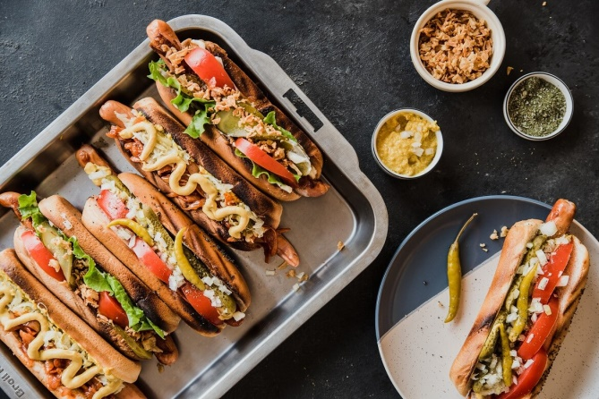
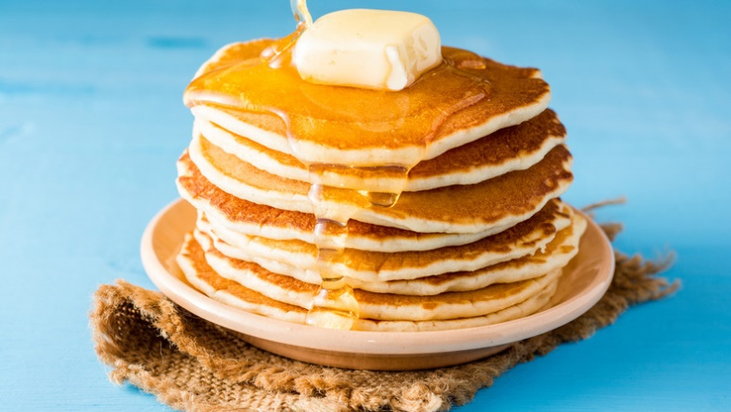
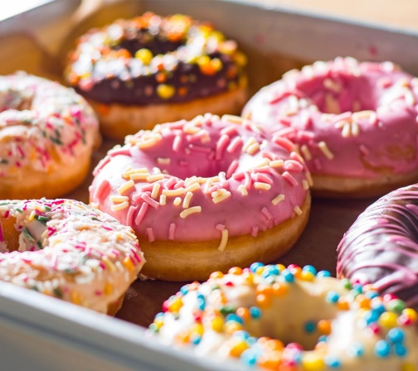
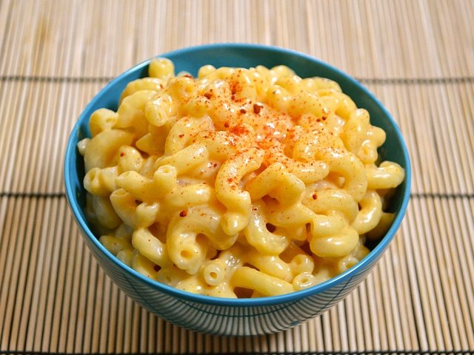
American’s food
Burgers
Grilled steak
Hot dogs
Pancakes
Donuts
Macaroni and cheese

Slide 14
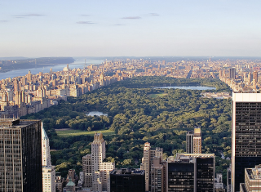
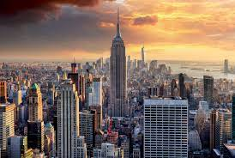
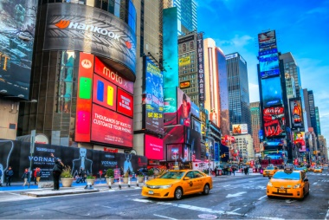
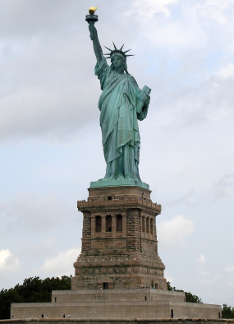
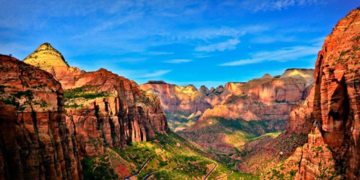
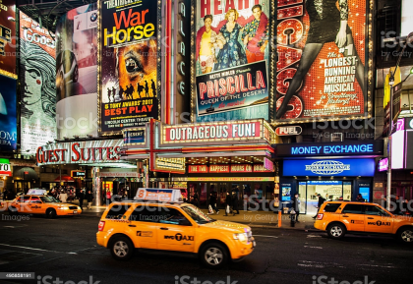
Tourist attractions
Central Park
Empire State Building
Times Square
Statue of liberty
Zion National Park
Broadway (Manhattan)

Slide 15
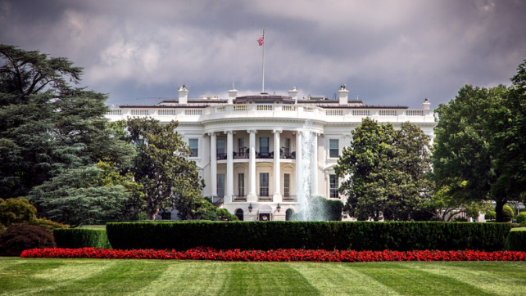
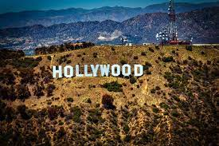
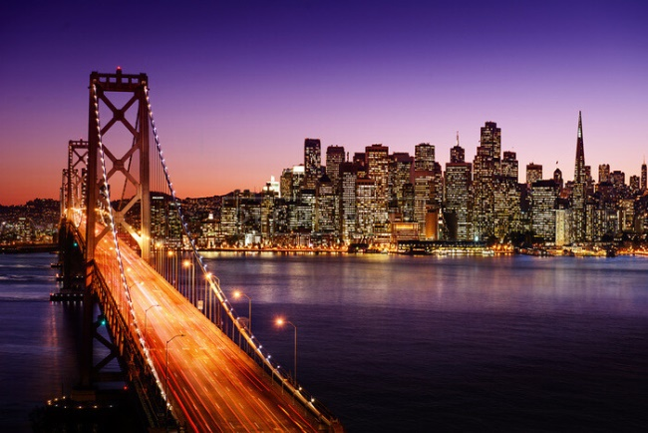
Why would we like to go to America
We would like to go to America because we could visit Hollywood which is a movie city. We would take a picture with the city's great inscription. We would visit the white house and we would cross the Bay Bridge.

Slide 16
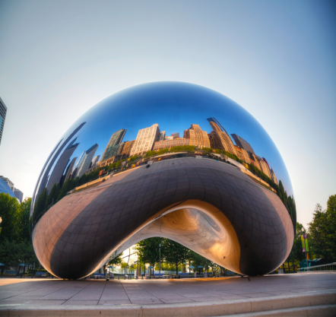
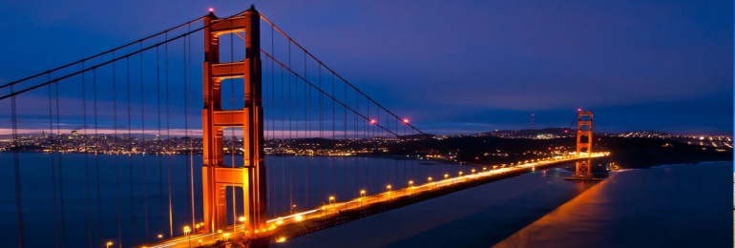
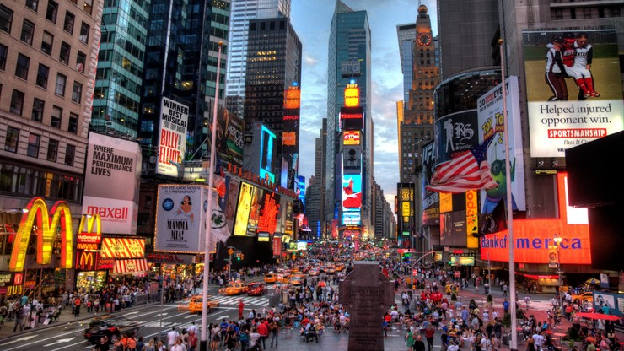
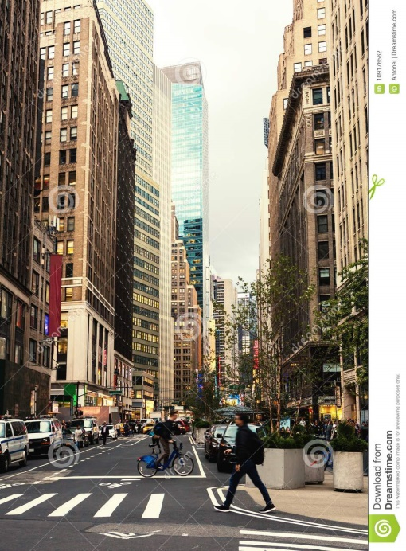
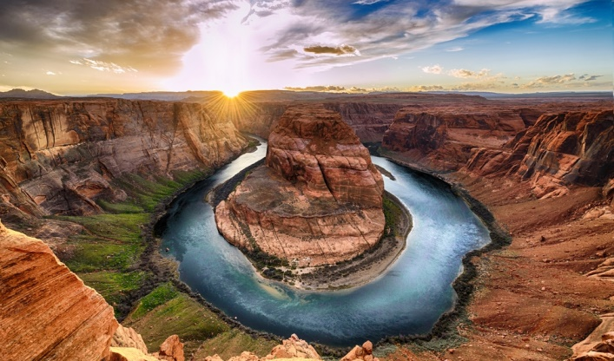
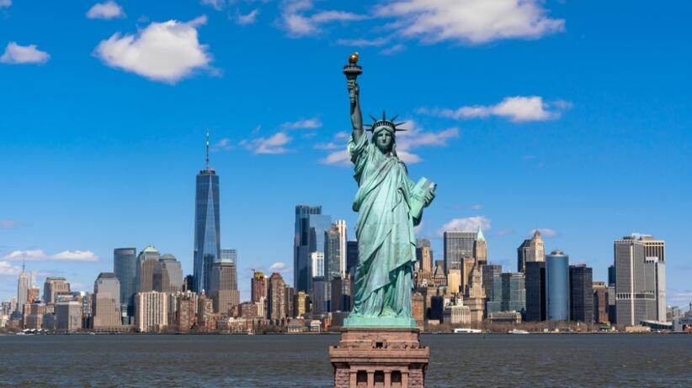
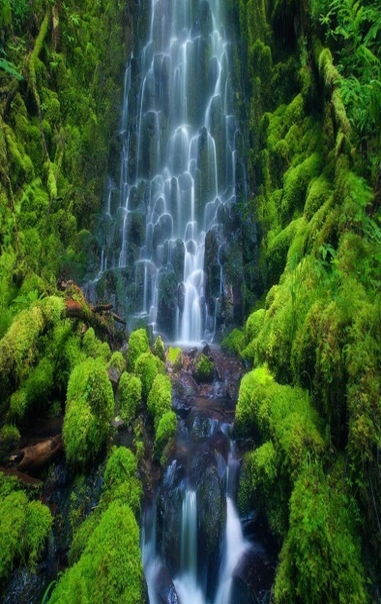
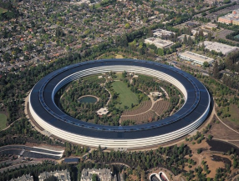
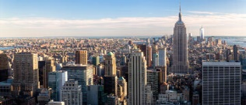
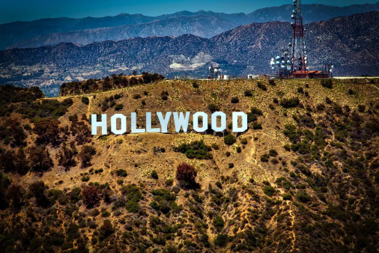
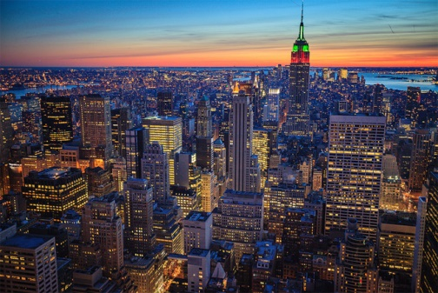
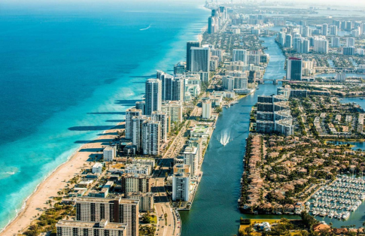
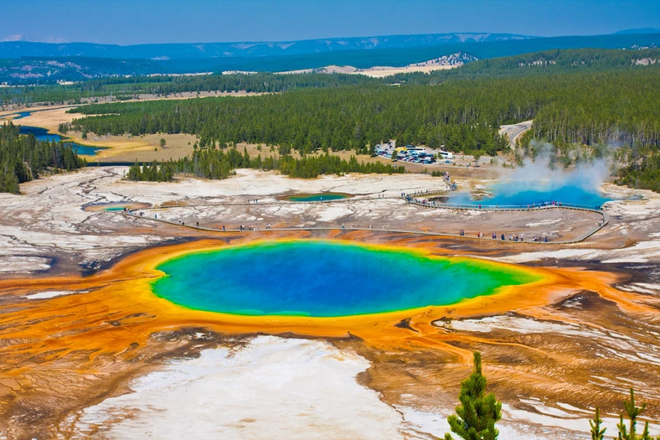
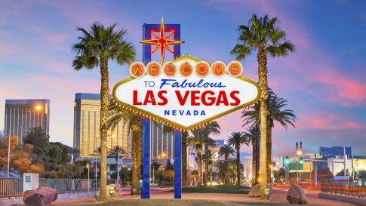
DZIĘKUJEMY ZA UWAGĘ!
Adam Mrozek Bartosz Szymanowski Grzegorz Styś 6a

